Slide 1
Big Mountain Resort
Choosing the best ticket price with data

Slide 2
Problem Identification
What is a daily ski ticket price that matches the value offered by the resort’s current facilities?
What investments or reductions in ski resort facilities can be made to lower costs or justify a ticket price increase?

Slide 3
Key Findings and Recommendations
Current facilities support a ticket price of about $94 ($84-$104)
Your best choice for investment is to increase vertical drop by 150 feet. This change supports a ticket price increase of $2.

Slide 4
Modeling results and analysis
We built a model with the data from 33 features at 276 resorts
We identified the key features of a resort:
Number of fast quad ski lifts
Number of runs
Acres of snow making
Vertical drop

Slide 5
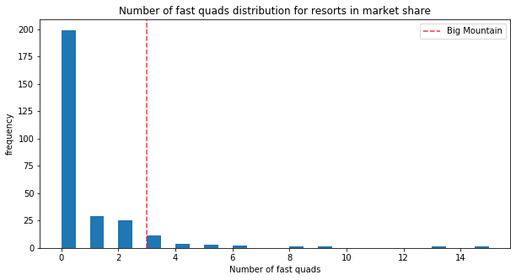
Modeling results and analysis
Three fast quads beats most resorts nationally.

Slide 6
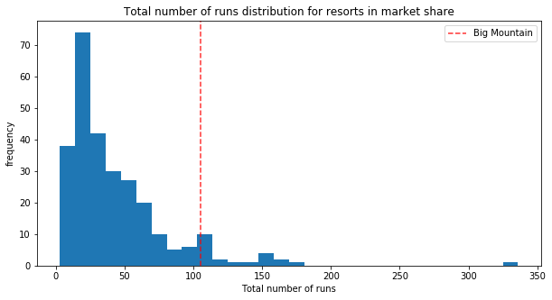
Modeling results and analysis
105 runs beats most resorts nationally,

Slide 7
Modeling results and analysis
Business Scenario | Change in revenue (through ticket price)
Close up to 10 runs | Losses of $300,000 to $1.5 million
150 feet to vertical drop + 1 chair lift | Gains of $3.5 million
Same as above + 2 acres of snowmaking | Same as above
+0.2 miles to longest run + 4 acres of snow | No change

Slide 8
Summary and Conclusion
Big Mountain can make an informed decision about ticket price
Current nation-leading facilities justify pricing at $84-104
Pursue increase in vertical drop with confidence
Use our model to make future decisions on facilities and ticketing

